Slide 1
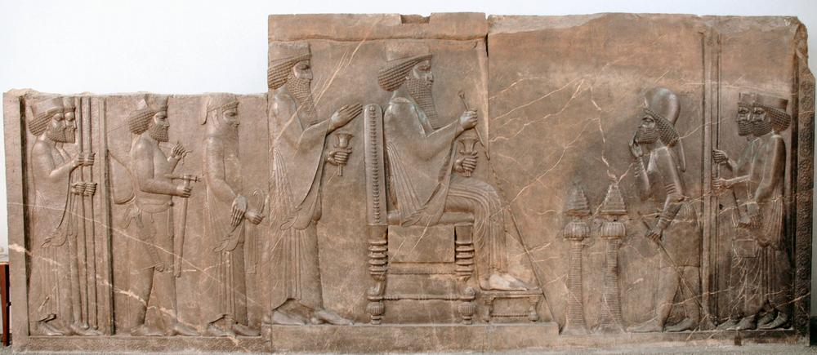
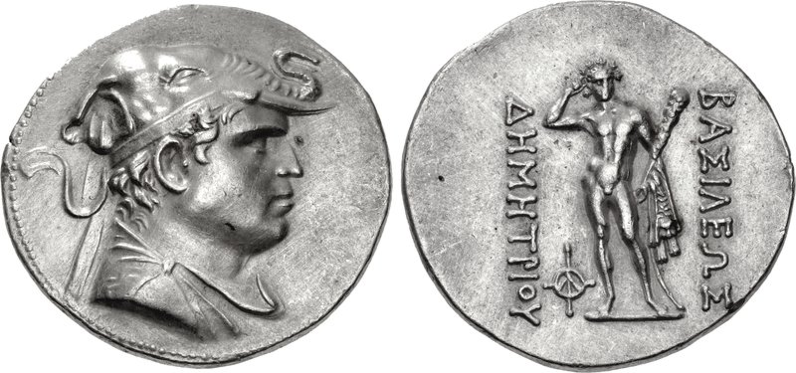
After Darius: The Bactrian Campaign; Dissent, Conspiracy, and Murder (330-327 BCE)
Relief with Proskynesis scene (Darius I), from the Apadana at Persepolis
Coin of Demetrios I, Greco-Bactrian Kingdom (early 2nd cent. BCE)

Slide 2
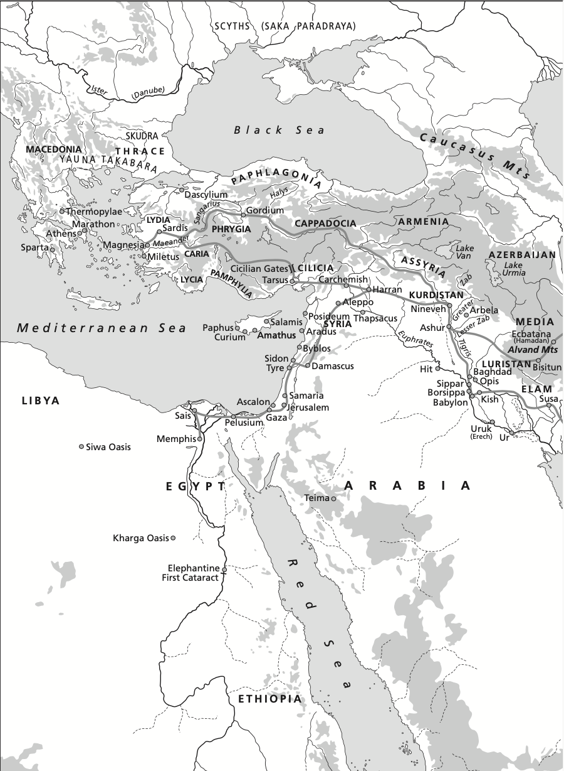
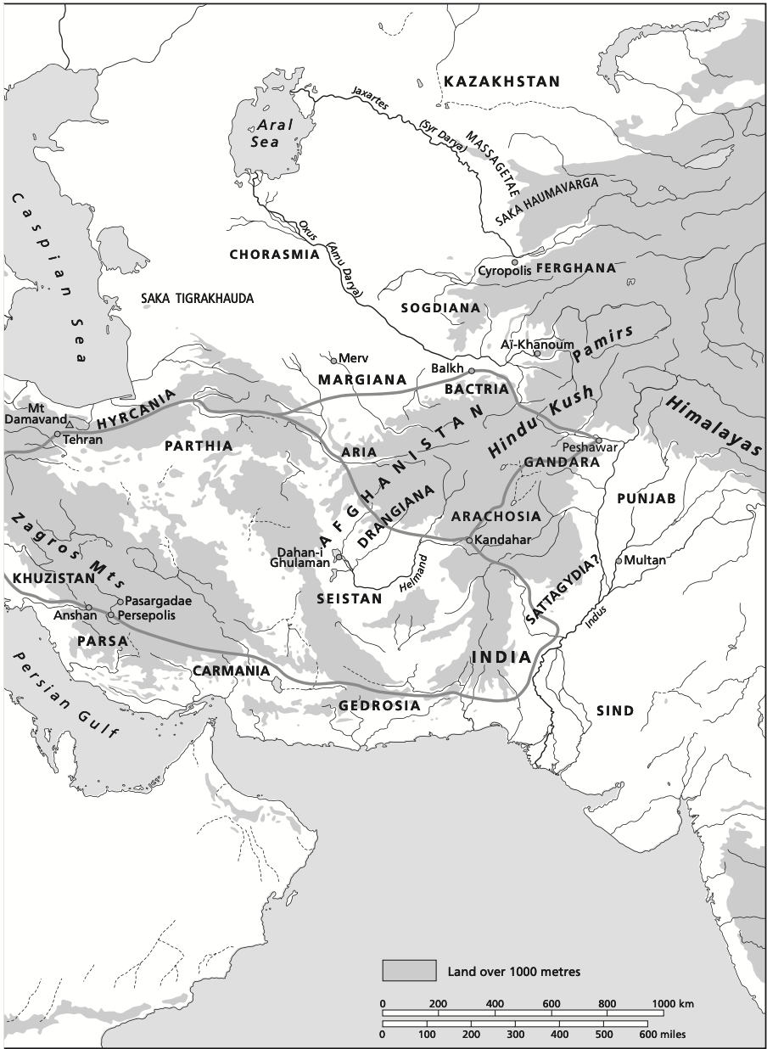

Slide 3
After Darius: The Conspiracy of (against?) Philotas
*After Darius’ death there were clear tensions between Alexander and an unknown percentage of his army:
-> The Greek forces were sent home with pay.
-> A contingent (represented by Parmenion) clearly wanted an eastern frontier at the Euphrates river.
-> Plutarch (47) relates that these tensions were mentioned by Alexander in a letter to Antipater
-> Plutarch also states that it was at this junction that Alexander began to adapt more and more of his habits to Persian custom (esp. in a court setting), creating a division among those who approved and the traditionalists.
*Parmenion was away from the army in Media; but it was in this context that suspicions of disloyalty against he and his son Philotas came to a head…
*According to Ptolemy and Aristobulus (Arrian 3.26.1), reports of a plot against A. by Philotas had been known (and dismissed) since Egypt.
*But with the environment drastically changed, Philotas was questioned, and evidence supposedly brought forward of a plot which Philotas did nothing to stop.
*With his ‘trial’ over, Philotas and the conspirators were executed.

Slide 4
After Darius: The Conspiracy of (against?) Philotas
*Philotas’ execution was a dangerous move: he was the commander of the companion cavalry, and his father was the most respected of Philip’s generation of the Macedonian army.
*A. sent for Parmenion to be assassinated in Media: Arrian allows two possibilities… 1) Parmenion must have known of his son’s plot, or 2) he simply couldn’t be allowed to live after the action against Philotas.
*There may have been a broader purge of people close to Philotas at the time (Arrian 3.27.1-3); Ptolemy in fact benefited from the whole affair, one of the somatophylakes (bodyguards), Demetrios, was also arrested, and Ptolemy took his place (3.27.5).
*A subsequent reorganization of the command structure: companion cavalry (hetairoi) to be split between Hephaestion and Cleitus (distribution of power).
*On the eve of the Bactrian campaign we thus have several crucial turning points:
Abandonment of original justification for war (League of Corinth)
A clear desire to rule the empire as Great King
Related tensions in the ranks, and a willingness to put them down on A.’s part
Q) What are the incentives to keep going?

Slide 5
After Darius: The Challenge of Bessus and the Bactrian Campaign (330-329)
*Alexander clearly had no intention of letting Bessus claim the kingship for himself in his province, and he set out on a campaign against him.
*At the very outset of the campaign, some major problems emerged:
Satibarzanes, who was re-appointed satrap of Areia after surrendering to Alexander, launched a revolt there.
Satibarzanes may have planned this revolt all along, if he was indeed the one who reported to Alexander that Bessus had adopted the title and imagery of king in Bactria (QC 6.6.13)
*But Bessus and Satibarzanes’ rebellions also gave A. an opportunity, to play the avenger of Darius (quite a turn from 334!). Arrian (3.21.10) reports that Satibarzanes was one of the men who killed Bessus; we don’t see this elsewhere, but may reflect A.’s later propaganda.
*A. quickly turned to pursue Satibarzanes in Areia, taking half of his army on a rapid two-day march: Satibarzanes escaped with a small group, and Alexander set about punishing anyone suspected of joining his rebellion (3.25.7). Then another satrap, Arsaces, was appointed there.

Slide 6
After Darius: The Challenge of Bessus and the Bactrian Campaign (329)
*It was presumably a lesson for Alexander: instead of resuming the march into Bactria, he rejoined the army and marched for Drangiana, where another of Bessus’ killers, Barsaentes was satrap.
*Barsaentes fled to India, but evidently was sent back to Alexander, who had him executed (this was actually 3 years later!).
*It was here at Phrada in Drangiana where Philotas was tried and executed.
*From here the march against Bessus resumed, with A. securing the surrender of the provinces of Gedrosia and Arachosia, appointing Menon as satrap with a garrison. Only to find out that Satibarzanes was back in Areia with forces supplied by Bessus. An army under Artabazus and two Companions was sent to deal with the revolt and Satibarzanes is killed in battle.
*On the march north into Bactria through the Hindu Kush mountain range, Arrian tells us that A. founded another Alexandria at Mt. Caucasus (modern Bagram, N. of Kabul in Afghanistan).
-> Diodorus (17.83) gives evidence that this Alexandria, and surely many others, were essentially garrisons with a settler population imported (veterans, non-Macedonians, mercenary volunteers).

Slide 7
After Darius: The Challenge of Bessus and the Bactrian Campaign (329)
*Bessus prepared for A. by devastating the crops north of the mountains; but he had not united the region in defense and did not have the numbers to actually face A.’s army.
*Retreat into Sogdiana, N. of the Oxus river (Amu Darya, ~Modern Uzbekistan/Tajikistan) : recruitment for guerilla warfare against Alexander, incl. nomadic Saca peoples.
*This meant A. was able to sieze Bactria without fighting, and install garrisons and Artabazus as satrap. By summer 329, A. would march to the Oxus short on supplies and food, and cross the river on makeshift rafts (no boats or timber).
*Two Sogdian nobles came to A., reporting that they would turn Bessus over (dissent on his side too); Arrian (via Ptolemy) recounts Ptolemy’s initiative to secure the handover (Arrian 3.30.1-3); but Diodorus (17.83) reports a simple handover, and Arrian later notes that Aristobulus agrees with the latter version (3.30.5).
*A. would hold on to Bessus to get the maximum effect out of his execution; he was mutilated in a punishment with precedence for attempted usurpers in the Achaemenid empire, and shipped off to Ecbatana for a public execution.

Slide 8
Sogdiana (Summer 329-Summer 328)
*Quintus Curtius (7.5.28-35) alone reports the story that Alexander and his army massacred a town somewhere in Sogdiana in the process of seizing Bessus. This town was inhabited by the disgraced descendants of the Branchidae, from Miletus, who handed over the temple of Didyma to Xerxes in 479 BCE.
Looting and murder justified by righting a historic wrong
Omitted by Ptolemy and Aristobulus (maybe he really wasn’t there?); story is from the Vulgate tradition, but that doesn’t mean fictional.
A retroactive justification for an episode of frustrated violence?
*As A. made his way to the Jaxartes river (Syr-Darya), he once again chooses a site for a city foundation (Alexandria Eschate), a strategic outpost for dealing with Scythian nomads beyond the borders of the empire (Arrian 4.1).
*In the process he learns of a revolt across Sogdiana, and besieges the city of Cyropolis, first taking four other cities, in successive days, each time plundering the city, killing the men, and enslaving the women and children (Arrian 4.2).
*This resistance was led by Spitamenes, one of the Sogdian leaders who handed Bessus over to Alexander.

Slide 9
Sogdiana (Summer 329 – Summer 328)
*The revolt in Sogdiana is very difficult to understand or even reconstruct… the important points are:
This was a series of small attacks, raids, and general guerilla warfare. The term “insurgency” has often been used, but that assumes that this was a rebellion against Alexander’s legitimate rule, rather than resistance to an invading force.
Q) How might the history of the modern world impact our understanding of this difficult period of Alexander’s campaign?
The geography of the region was difficult, particularly as a border zone with nomadic peoples beyond the Syr-Darya -> groups of Scythians repeatedly joined Spitamenes’ efforts at resistance (mercenaries? ‘state’ actors? What is their interest in this fight?)
- The enemy was not new, and there were some precedents for the fighting (hills, e.g. in Balkans, against the Uxians); but the larger strategic elements were new for this campaign: multiple fronts, retreat and regroup.
- Much of Alexander’s diplomacy at this time was with independent kings beyond the borders of the empire. We can see an attempt at creating buffer-zones at a time of uncertainty.

Slide 10
Samarkand (Winter 328)
*There were still elements of resistance across Sogdiana, and Spitamenes was still at large. But many of Alexander’s forces would convene at Samarkand in the early winter.
*At a drunken party, Cleitus (the Black), was killed by Alexander. Sources of the episode vary in the details, but:
There was a lot of flattery of Alexander being thrown around, and putting down the achievements of his father Philip.
Cleitus, an ‘old-school’ Macedonian, spoke up. He may have been disgruntled by a ‘demotion’ from cavalry command to satrapy of Bactria/Sogdiana.
In the course of a verbal altercation, Alexander grabbed a weapon and killed Cleitus. In the aftermath, most of our sources report that A. intended to kill himself, but was restrained, and then grieved for several days.
The killing of Cleitus was not as politically significant as that of Philotas and Parmenion, but it was perhaps another expression of the same tensions.
*Over the course of that winter, Sitamenes scored some victories and defeats, and in the end was killed by his Massagetae allies, with his head being sent to A. (Arrian 4.17.7).

Slide 11
Out of the Upper Satrapies (Winter 328 - Summer 327)
*After two years of resistance in Bactria/Sogdiana, Alexander could finally look beyond immediate concerns, and south to India.
*Some new policies were implemented:
A much larger army than any previous garrisons was left behind in Bactria with its new satrap Amyntas (~10,000 infantry, 3,500 cavalry).
Colonization began to play a crucial role in pacifying conquered territory.
30,000 Bactrian youths were conscripted to be trained in Macedonian phalanx warfare .
*This period also brought several significant events for A. on the personal and political fronts:
In early spring of 327, A. married a girl from the Bactrian nobility, Roxane. This was obviously in part political (cf. Philip!), but it is significant that she was Alexander’s first wife.
Around the same time, A. began to experiment with proskynesis: this was a completely secular act of prostration to a superior (esp. the Great King) in Persian society. But in Greek culture it was an act reserved for gods.
The protest against this practice is centered on Callisthenes in our sources (esp. Arrian 4.10-12, in a lengthy set of speeches). Callisthenes must have been voicing a widely-held resentment, and soon after was arrested and executed, ostensibly for being implicated in the conspiracy of the pages (Arrian 4.14, citing Ptolemy and Aristobulus vs. Vulgate tradition of innocence).

Slide 12
The Conspiracy of the Pages (Spring 327)
*Following the public drama with Callisthenes, another conspiracy against Alexander’s life was uncovered, this time it was much more likely to be real (source unanimity).
*One Hermolaus was identified as the ringleader: he had previously been publicly humiliated after a violation of protocol on a boar hunt with Alexander (Arrian 4.13.2), and gathered several people in a plot to kill A. in his sleep.
*For whatever reason, they didn’t go through with the plan, and the plot was exposed the next day. In Arrian’s account, it was Ptolemy who got word of the plot and relayed it to Alexander (4.13.7).
*Those named were arrested and tortured for confessions; Arrian’s main sources say they also gave up the name of Callisthenes as the one who incited them. Plutarch seems to take the implication of Callisthenes quite personally, and says it is all slander (55).
*Every source seems to have a different version of what actually happened to Callisthenes after. Either he was actually part of the plot, or the plot represented a convenient moment to be rid of him as he had become too publicly critical of Alexander.

Slide 13
Issues
*A critical period for both the military and administrative evolution of Alexander’s conquest.
*Bactria/Sogdiana campaign is hopelessly entwined with modern histories of empire and resistance… can we hope to understand what Bessus and Spitamenes and their allies hoped to achieve?
*Alexander and the necessities of rule: was there any way to secure his rule over an empire that placed so much emphasis on the ruler, and at the same time keep his army on board?
*New problems, new solutions: settlements and colonization, extra-imperial diplomacy, management of boarder regions, new fighting tactics all adopted as necessities in a deeply changed environment.
*Resentment, Dissent, Conspiracy: was there any solution to avoid alienating his army? Are these isolated episodes, or can we connect everything from Philotas and Parmenion to the pages and Callisthenes into a narrative?
*With so much trouble within the borders of the Achaemenid empire, why on earth would Alexander want to expand beyond them? (India; hints of future plans in his diplomacy with Chorasmian king, e.g.).

